Slide 1

Front End Engineering-II
Project Report Semester-IV (Batch-2022)
PALINDROME CHECKER
Supervised By:
Raveesh Samkaria
Submitted By:
Yashita Prajapati
2210990980
G-14
Department of Computer Science and Engineering Chitkara University Institute of Engineering & Technology,
Chitkara University, Punjab

Slide 2
1. INTRODUCTION
1.1 BACKGROUND
The Palindrome Checker project aims to provide a simple and intuitive tool for users to determine whether a given input string is a palindrome or not. A palindrome is a word, phrase, number, or other sequence of characters that reads the same forward and backward, ignoring spaces, punctuation, and capitalization. This project leverages web technologies to create an interactive and visually appealing user interface for palindrome checking.
The Palindrome Checker project emerges from the need to provide users with a convenient tool for verifying whether a given string is a palindrome. Palindromes, being sequences of characters that read the same forward and backward, are of interest in various fields such as linguistics, mathematics, and computer science. This project aims to harness the power of web technologies to offer a user-friendly solution for checking palindromes.
Here's a breakdown of the background elements:
Educational Purpose: Beyond its practical utility, the Palindrome Checker serves an educational purpose. It provides an interactive platform for users to learn about palindromes and understand the logic behind checking them programmatically. Through real-time feedback and clear messaging, users can grasp the concept of palindromes more effectively.
Technological Innovation: Leveraging modern web development technologies such as Alpine.js for interactivity and Tailwind CSS for styling, this project showcases the latest advancements in front-end web development. By adopting these frameworks and libraries, the Palindrome Checker delivers a seamless and visually appealing user experience.
Accessibility Considerations: Accessibility is a key consideration in the design of the Palindrome Checker. By ensuring compatibility with screen readers, keyboard navigation, and other assistive technologies, the project aims to make palindrome checking accessible to all users, regardless of their physical abilities.

Slide 3
1.2 OBJECTIVES
User-Friendly Interface: The primary objective of the project is to design a user-friendly interface that allows users to easily input a string and receive instant feedback on whether it is a palindrome or not.
Real-Time Feedback: The project aims to provide real-time feedback to users as they type, dynamically updating the result based on the input provided. This ensures a smooth and responsive user experience.
Accessibility: Another objective is to ensure accessibility for all users, including those with disabilities. The interface should be designed with accessibility features in mind, such as keyboard navigation and screen reader compatibility.
Cross-Platform Compatibility: The project aims to ensure cross-platform compatibility, allowing users to access the Palindrome Checker from various devices and browsers without any loss of functionality.
Code Efficiency: Behind the scenes, the project focuses on writing clean and efficient code to optimize performance and maintainability. This includes leveraging modern web development libraries and frameworks for streamlined development.
Visual Appeal: The interface is designed to be visually appealing, with a combination of colors, fonts, and animations to enhance the user experience and make the Palindrome Checker engaging and enjoyable to use.

Slide 4
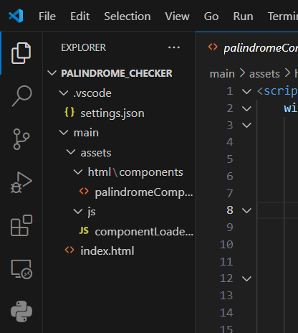
File Structure in VS code snippet
PROBLEM DEFINITION AND REQUIREMENTS

Slide 5
Requirements
Input Interface:
Provide a text input field where users can enter the string to be checked for palindrome.
Ensure the input field is user-friendly, allowing easy entry and editing of text.
Validation:
Validate the input to ensure it contains at least one alphanumeric character.
Handle empty inputs and display appropriate error messages to the user.
Processing:
Remove special characters, spaces, and convert all characters to lowercase for consistent comparison.
Implement the logic to determine whether the input string is a palindrome.
Display real-time feedback to the user as they input text, indicating whether the current input is a palindrome or not.
Output Display:
Display the result of the palindrome check to the user.
Provide clear and concise messages indicating whether the input string is a palindrome or not.
User Experience:
Ensure a smooth and responsive user experience, with minimal latency between input and feedback.
Design the interface to be visually appealing and intuitive, enhancing user engagement.
Accessibility:
Ensure accessibility features such as keyboard navigation and screen reader compatibility.
Make the application usable by people with disabilities, including those with visual or motor impairments.
Cross-Platform Compatibility:
Ensure compatibility with various web browsers and devices, including desktops, laptops, tablets, and smartphones.
Optimize the application for responsiveness and usability across different screen sizes and resolutions.
Performance:
Optimize code efficiency and minimize unnecessary computations to ensure fast response times.
Handle edge cases efficiently, such as long input strings or inputs containing special characters.
Code Maintainability:
Write clean, modular, and well-documented code to facilitate future maintenance and updates.
Follow best practices in web development to ensure code readability and scalability.
Testing:
Implement comprehensive testing procedures to validate the correctness and reliability of the application.
Conduct both manual and automated testing to identify and address any bugs or issues.

Slide 6
Methodologies - Code snippets
HTML code
<!DOCTYPE html>
<html lang="en">
<head>
<meta charset="UTF-8">
<meta name="viewport" content="width=device-width, initial-scale=1.0">
<title>Palindrome Checker</title>
<script src="https://cdn.jsdelivr.net/npm/alpinejs@3.13.3/dist/cdn.min.js" defer></script>
<script src="https://cdn.tailwindcss.com"></script>
<link href="https://cdn.tailwindcss.com" rel="stylesheet">
<link href="styles.css" rel="stylesheet">
<style>
body {
background-image: url('https://c4.wallpaperflare.com/wallpaper/27/995/633/simple-background-violet-gradient-wallpaper-preview.jpg');
background-size: cover;
background-position: center;
background-repeat: no-repeat;
height: 100vh;
margin: 0;
display: flex;
justify-content: center;
align-items: center;
}
.container {
background-color: rgba(255, 255, 255, 0.8);
padding: 20px;
border-radius: 10px;
box-shadow: 0 0 20px rgba(0, 0, 0, 0.2);
text-align: center;
max-width: calc(100vw - 300px);
width: 100%;
margin: 0 150px;
animation: fadeIn 1s ease;
}
.risotto-font {
font-family: 'Risotto Script', cursive;
color: rgba(0, 0, 0, 0);
animation: pulse 1s infinite alternate;
}

Slide 7
@keyframes fadeIn {
from {
opacity: 0;
}
to {
opacity: 1;
}
} @keyframes pulse {
from {
transform: scale(1);
}
to {
transform: scale(1.1);
}
}
</style>
<link rel="stylesheet" href="https://fonts.googleapis.com/css2?family=Risotto+Script&display=swap">
</head>
<body >
<div class="container">
<div class="header-container">
<h1 class="risotto-font text-black text-6xl font-bold">Palindrome Checker</h1>
</div>
<section class="p-5 flex flex-col gap-5 justify-center items-center rounded-lg">
<div x-data="{}" x-init="loadComponent('palindromeComponent', $el)"></div>
</section>
</div>
<script src="assets/js/componentLoaderHelpers.js"></script>
</body>
</html>
(2) Palindrome compoment of HTML
<script>
window.palindromeComponentData = function () {
return {
palindromeValue: "",
showResults: false,
isSuccessfullResults: false,
resultsMessage: "",
checkPalindrome() {
this.showResults = true;
// If the input is empty
if (!this.palindromeValue) {
this.isSuccessfullResults = false;
this.resultsMessage =
"You need to provide a value in order to check if it is a palindrome!";
return;
}

Slide 8
const input = this.palindromeValue.toString(); // Convert input to string
// Remove special characters and spaces from the input
const sanitizedInput = input.replace(/[^A-Za-z0-9]/g, "").toLowerCase();
// Check if the sanitized input is empty after removing special characters
if (!sanitizedInput) {
this.isSuccessfullResults = false;
this.resultsMessage =
"Invalid input! Please provide a valid alphanumeric value.";
return;
}
// Reverse the input
const reversedInput = sanitizedInput.split("").reverse().join("");
// Check if the input and its reverse are equal
if (sanitizedInput !== reversedInput) {
this.isSuccessfullResults = false;
this.resultsMessage =
`${this.palindromeValue} is not a palindrome!`;
return;
}
this.isSuccessfullResults = true;
this.resultsMessage = `${this.palindromeValue} is a palindrome!`;
},
};
};
</script>
<div
x-data="palindromeComponentData();"
class="flex flex-col gap-2 shadow-lg w-100 px-3 py-5 rounded-lg bg-gradient-to-br from-purple-400 to-pink-300"
>
<form action="" class="flex gap-2">
<input
type="text"
name="palindromeValue"
id="palindromeValue"
placeholder=" Input"
class="w-full h-full p-2 border-2 rounded-md placeholder-purple-400 focus:ring-purple-500 focus:ring focus:ring-offset-2 focus:ring-offset-white"
x-model="palindromeValue"
/>

Slide 9
<button
type="button"
class="text-white bg-gradient-to-br from-purple-500 to-purple-700 hover:from-purple-700 hover:to-purple-900 rounded"
@click="checkPalindrome();"
>
<div class="hover:scale-110 px-4 py-1">Check</div>
</button>
</form>
<div
x-show="showResults"
x-html="resultsMessage"
class="p-3 text-white font-bold bg-gradient-to-br rounded-lg shadow-lg"
:class="{'from-green-500 to-green-700': isSuccessfullResults,
'from-red-500 to-red-700': !isSuccessfullResults}"
></div>
</div>

Slide 10
(2) JS code
function executeScripts(html) {
const parsedHTML = new DOMParser().parseFromString(html, "text/html");
parsedHTML.querySelectorAll("script").forEach((script) => {
const scriptContent = script.textContent;
const scriptFunction = new Function(scriptContent);
scriptFunction();
});
}
function loadComponent(componentName, dom, data = {}) {
if (!(dom instanceof Element))
throw new Error("Invalid DOM element provided!");
fetch(`assets/html/components/${componentName}.html`)
.then((response) => response.text())
.then((html) => {
if (Object.keys(data) !== 0) {
html = replacePlaceholders(html, data);
}
// Assuming you have a specific container in your main.html
executeScripts(html);
dom.outerHTML = html;
});
}
function replacePlaceholders(html, data) {
for (const key in data) {
if (data.hasOwnProperty(key)) {
const placeholder = new RegExp(`{{\\s*${key}\\s*}}`, "g");
html = html.replace(placeholder, formatXData(data[key]));
}
}
return html; function formatXData(data) {
let output = "";
switch (typeof data) {
case "object": {
output = `{ ${Object.entries(data)
.map(
([key, value]) =>
`${key.replace(/'/g, "\\'")}: '${
typeof value === "string"
? value.replace(/'/g, "\\'")
: value
}'`
)
.join(", ")} }`;
break;
}

Slide 11
case "string": {
output = data.replace(/'/g, "\\'");
//"'" + data.replace(/'/g, "\\'") + "'";
break;
}
default: {
output = data;
break;
}
}
return output;
}

Slide 12
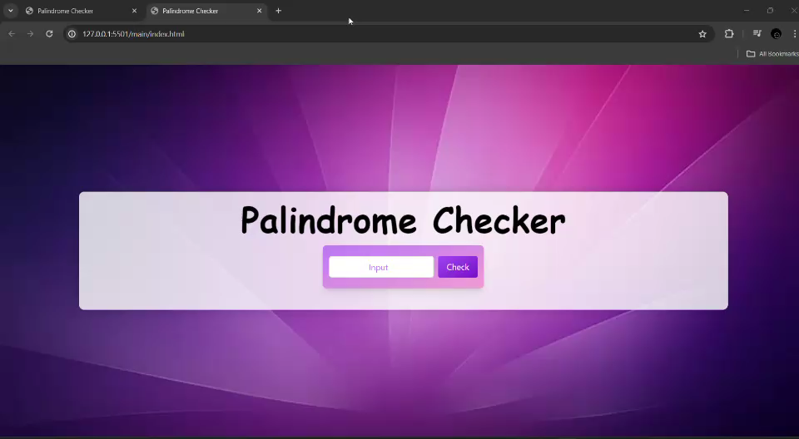
Result
Snippets of the resultant webpage are attached below:-
(1) DESKTOP VIEW

